Slide 1
Quantitative Foundations
Project 4: Dimensionality Reduction and Classification
Ayush Kumar Shah
Kai North
Date: 3 Dec 2020

Slide 2
Using PCA to extract eigenfaces

Slide 3
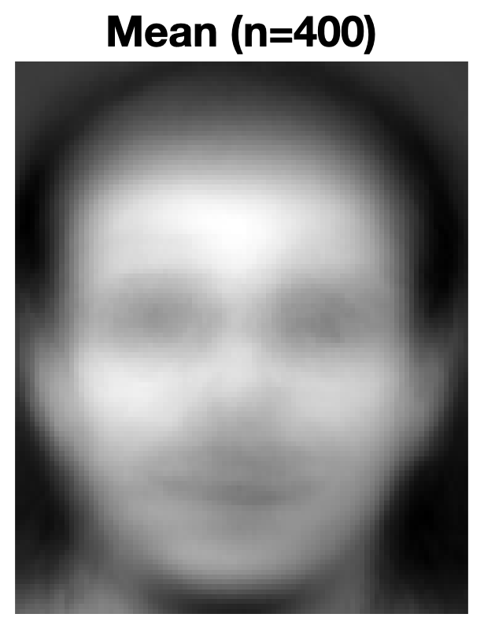
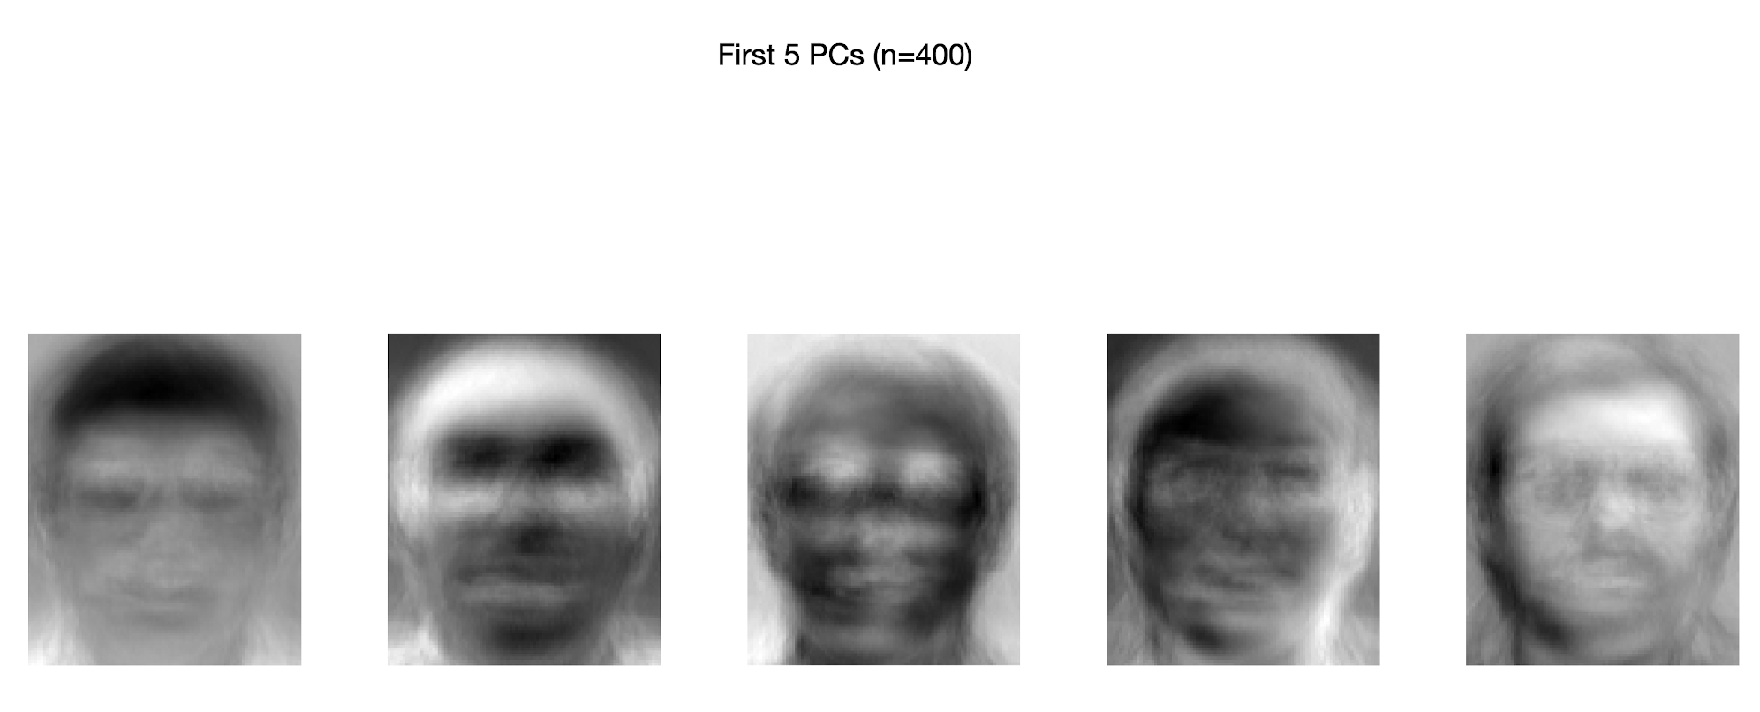
How do the leading eigenfaces look like as an image?

Slide 4
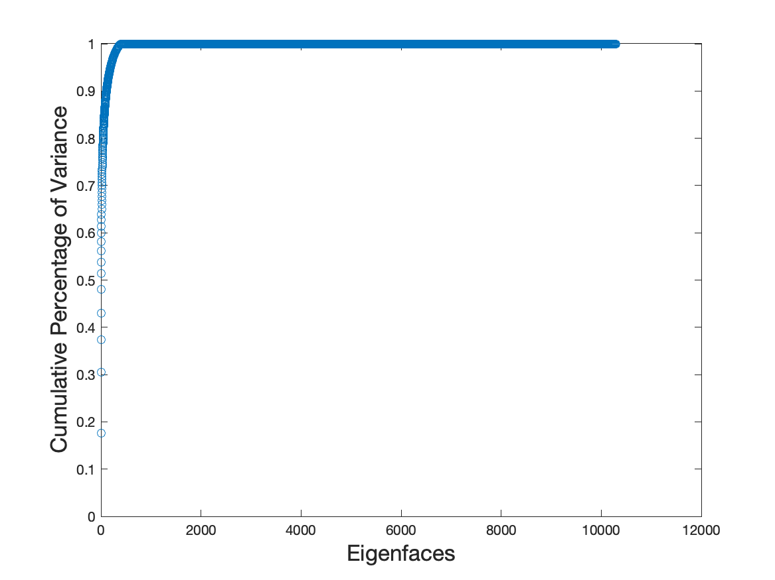
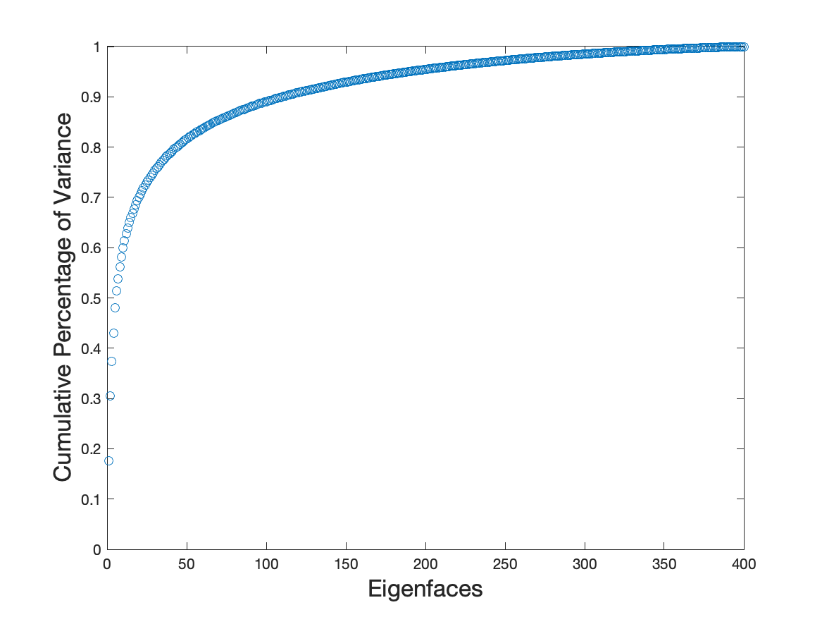
How does the importance of the eigenfaces decrease?

Slide 5
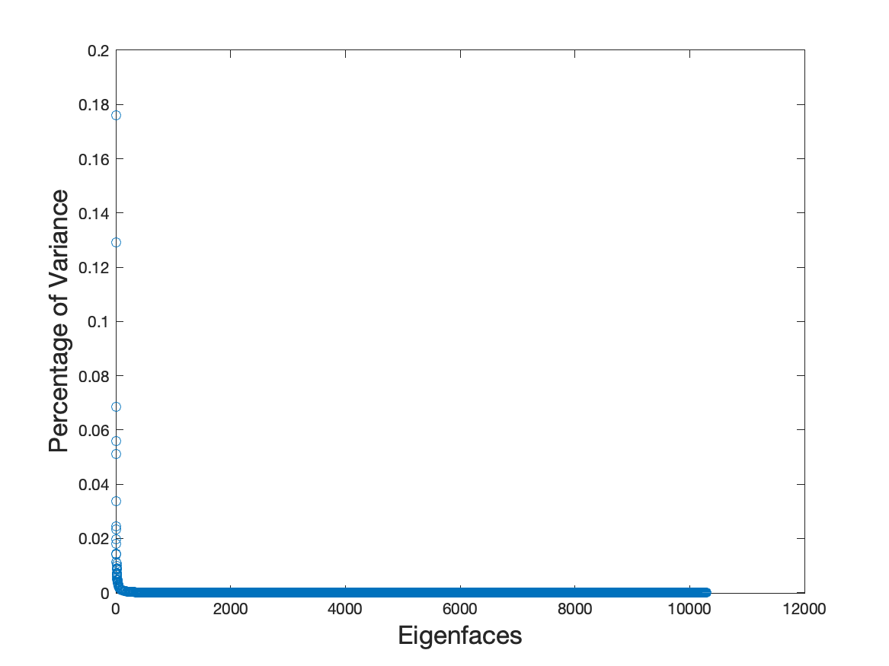
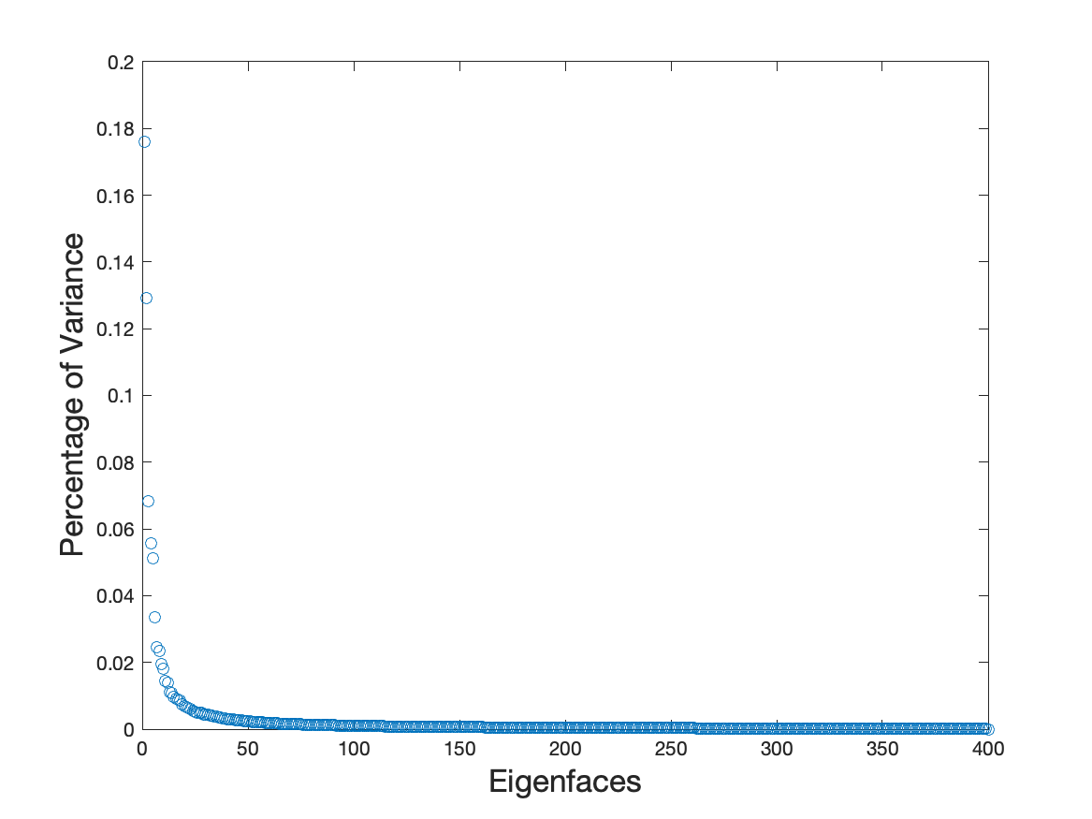
How does the importance of the eigenfaces decrease?

Slide 6
Face Reconstruction with PCA

Slide 7
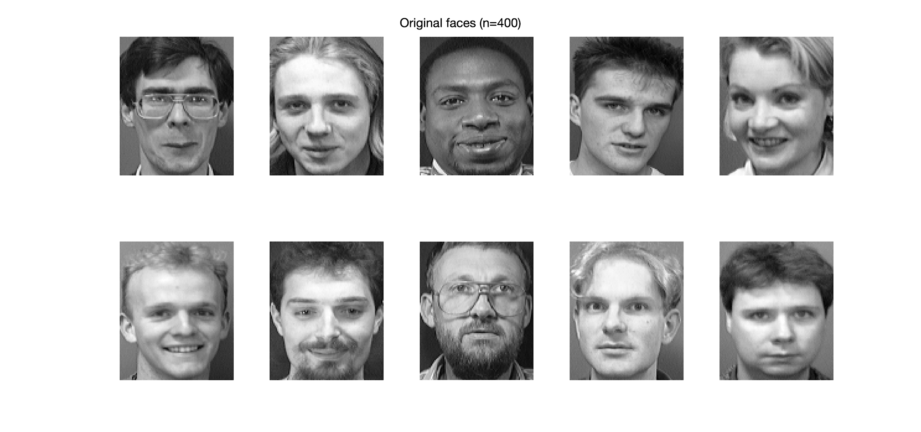
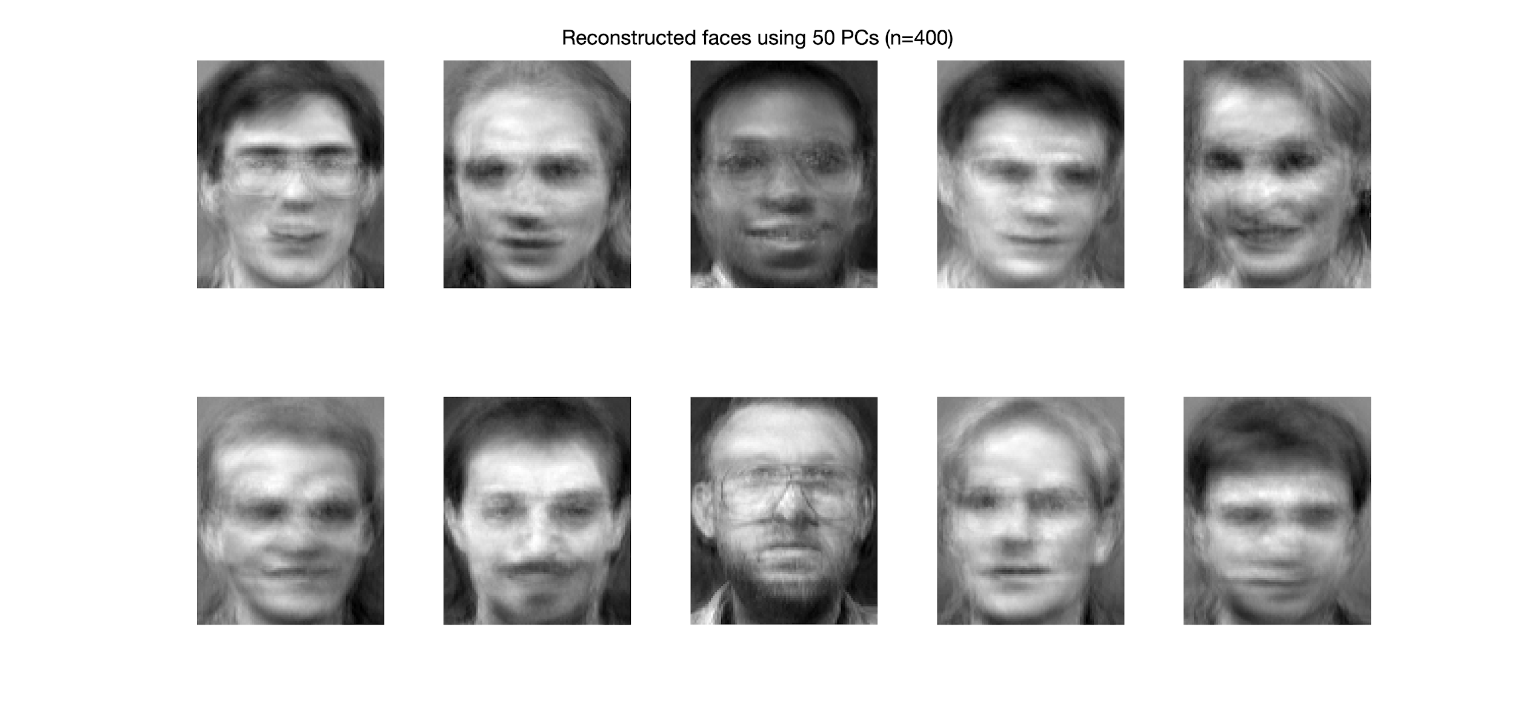
Differences between reconstructed and original images
Original Faces
Reconstructed Faces using 50 Eigenfaces

Slide 8
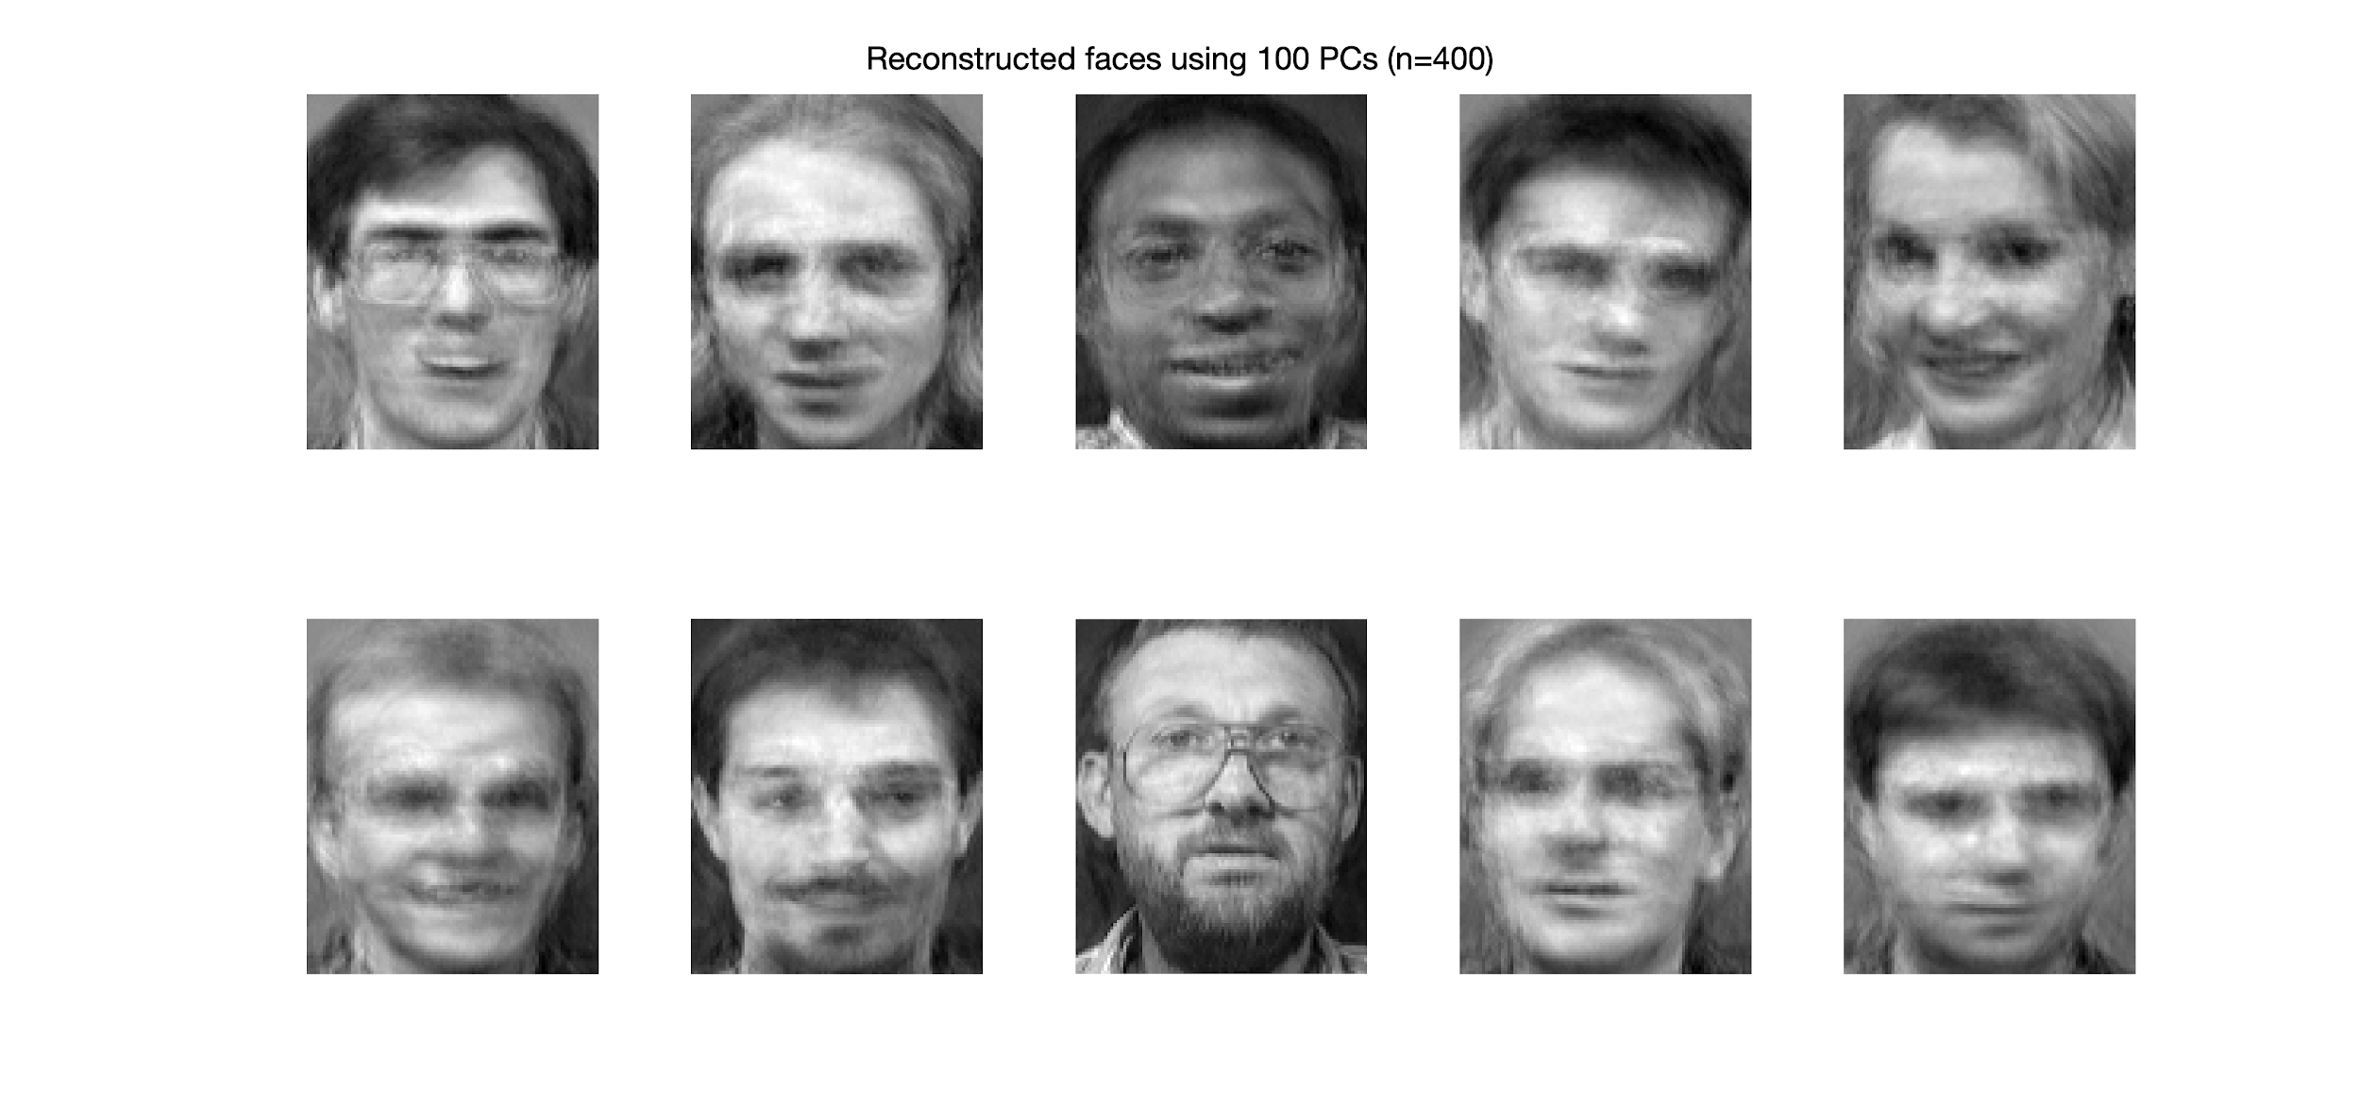
Differences between reconstructed and original images
Original Faces
Reconstructed Faces using 100 Eigenfaces

Slide 9
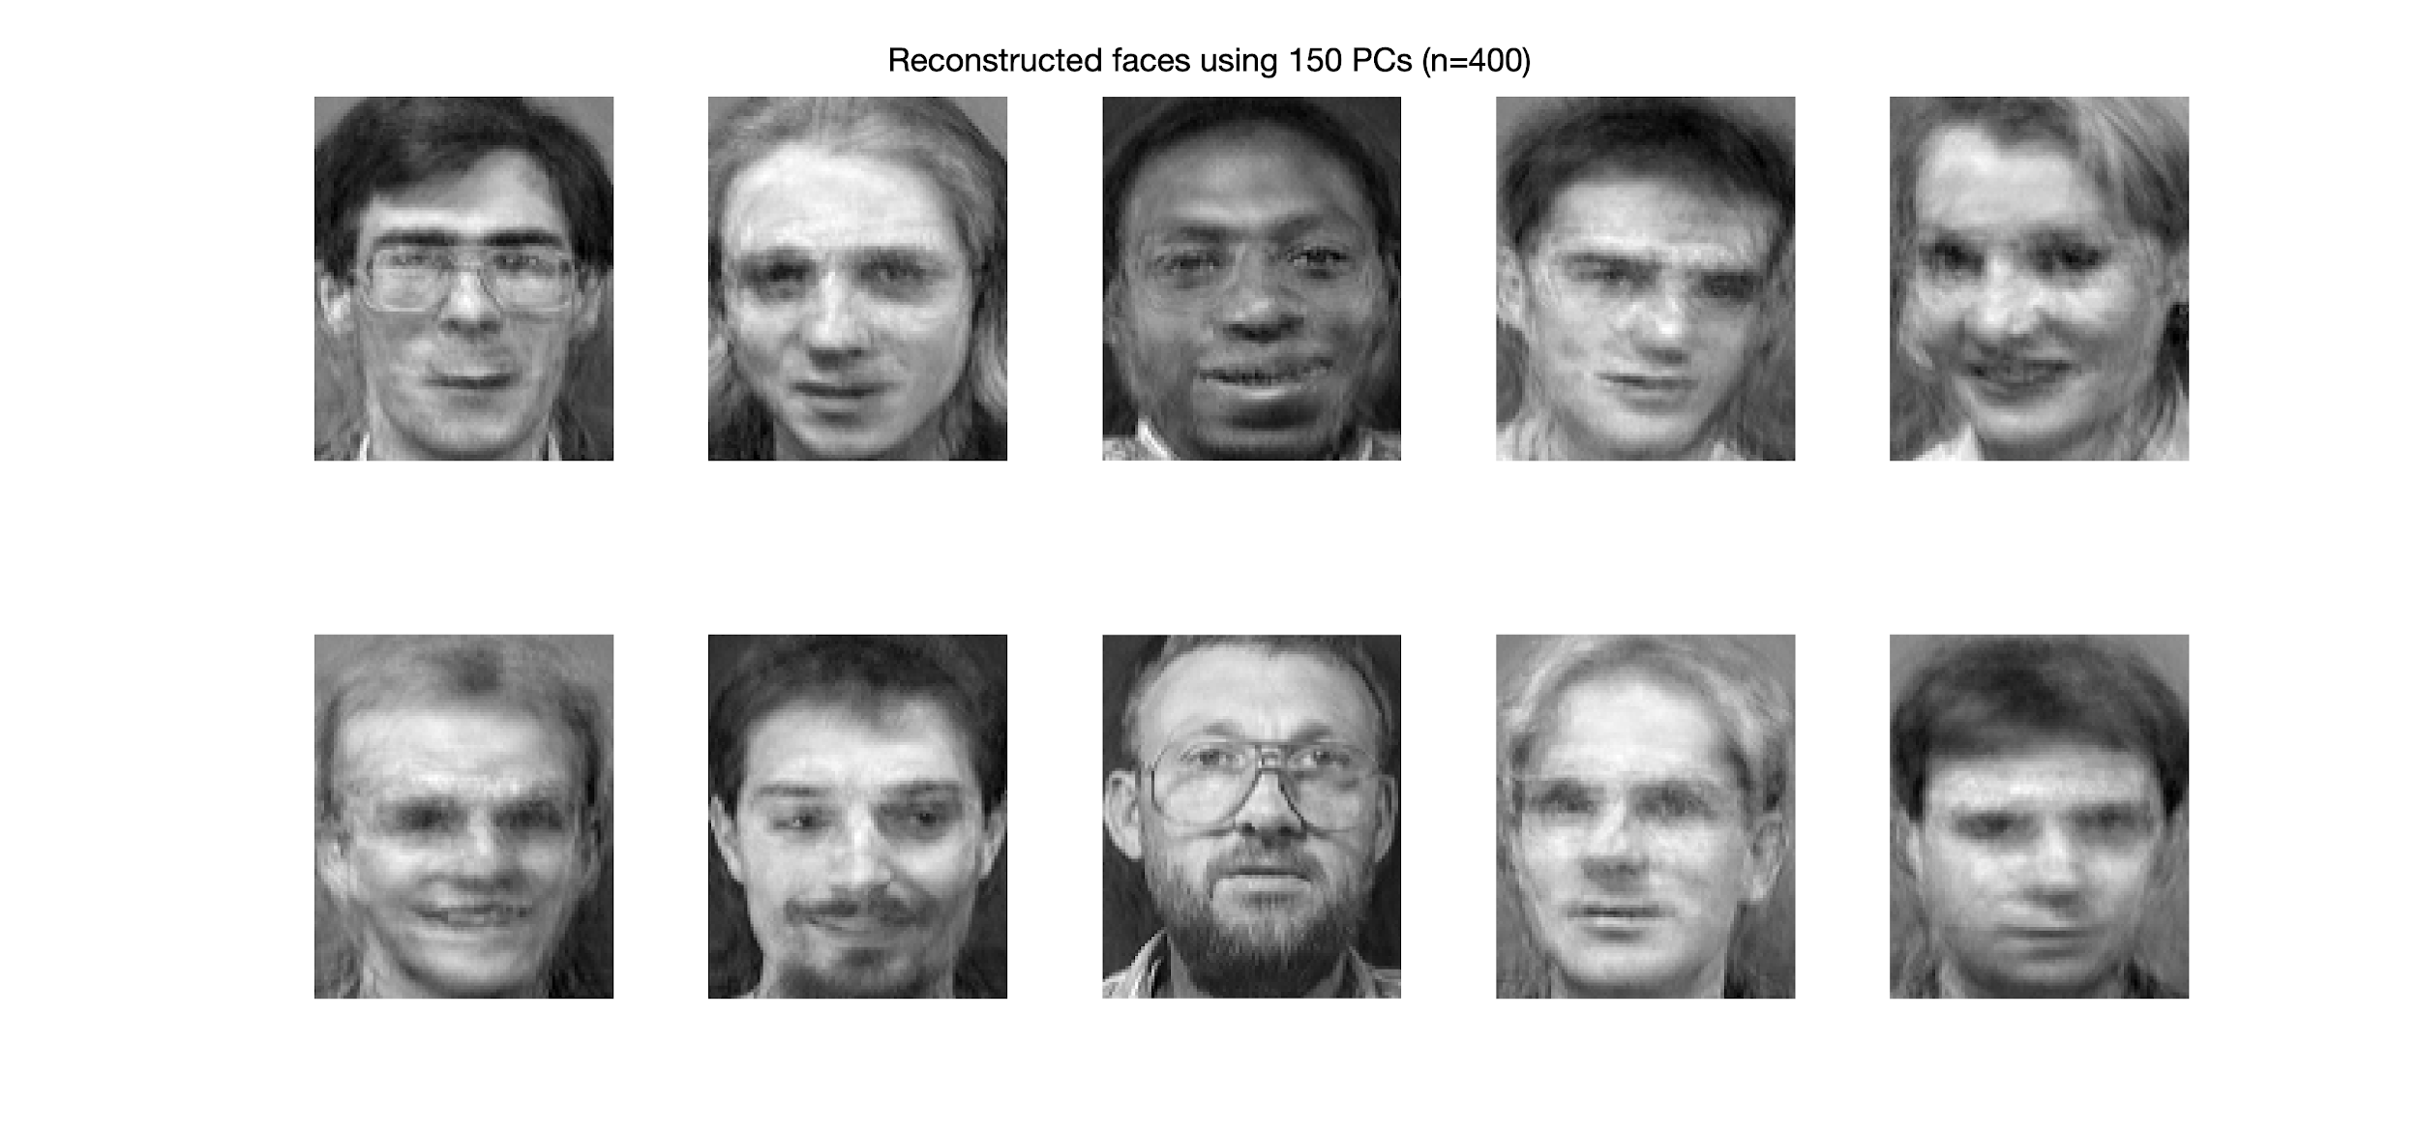
Differences between reconstructed and original images
Original Faces
Reconstructed Faces using 150 Eigenfaces

Slide 10
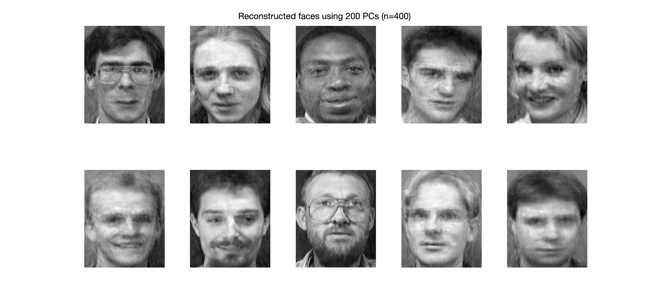
Differences between reconstructed and original images
Original Faces
Reconstructed Faces using 200 Eigenfaces

Slide 11

Differences between reconstructed and original images
Original Faces
Reconstructed Faces using 250 Eigenfaces

Slide 12
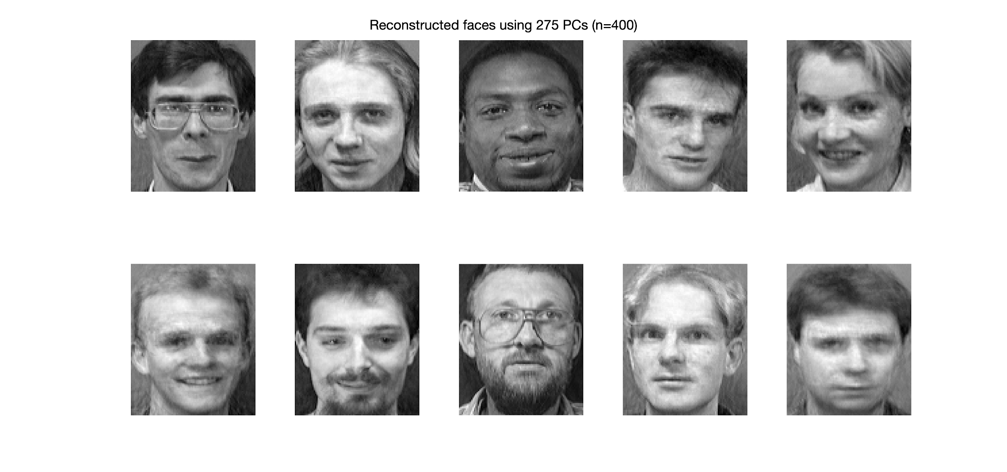
Differences between reconstructed and original images
Original Faces
Reconstructed Faces using 275 Eigenfaces

Slide 13

Differences between reconstructed and original images
Original Faces
Reconstructed Faces using 300 Eigenfaces

Slide 14
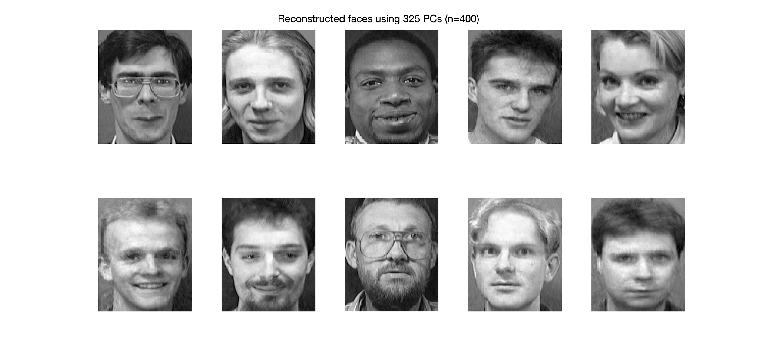
Differences between reconstructed and original images
Original Faces
Reconstructed Faces using 325 Eigenfaces

Slide 15
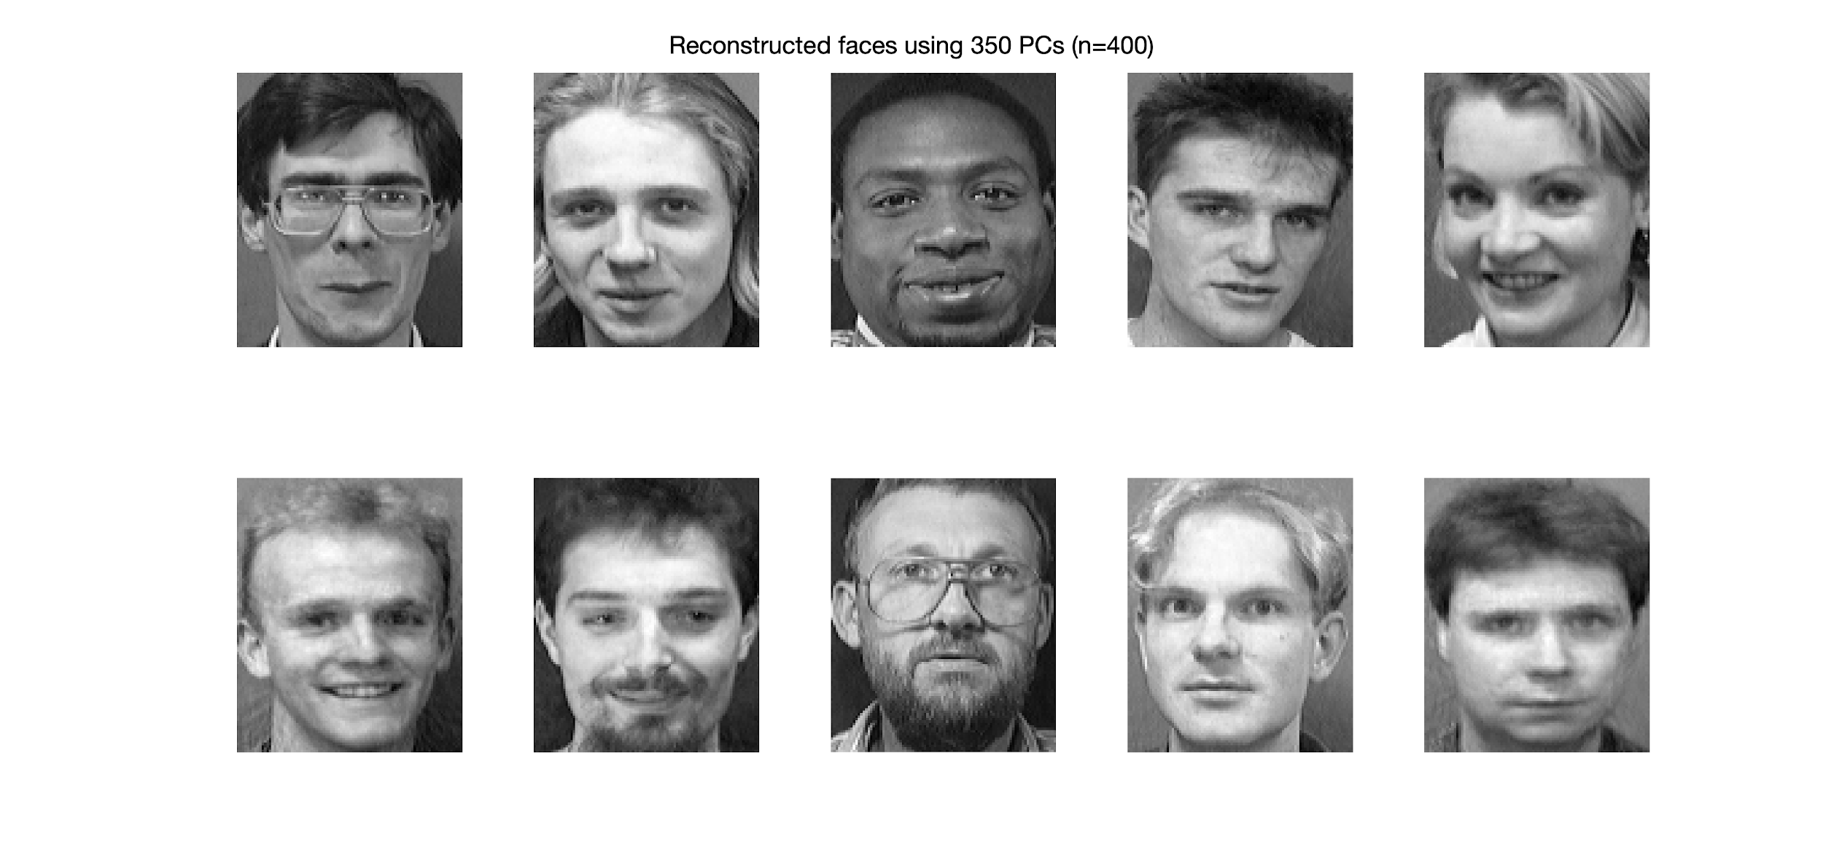
Differences between reconstructed and original images
Original Faces
Reconstructed Faces using 350 Eigenfaces

Slide 16

Differences between reconstructed and original images
Original Faces
Reconstructed Faces using 375 Eigenfaces

Slide 17
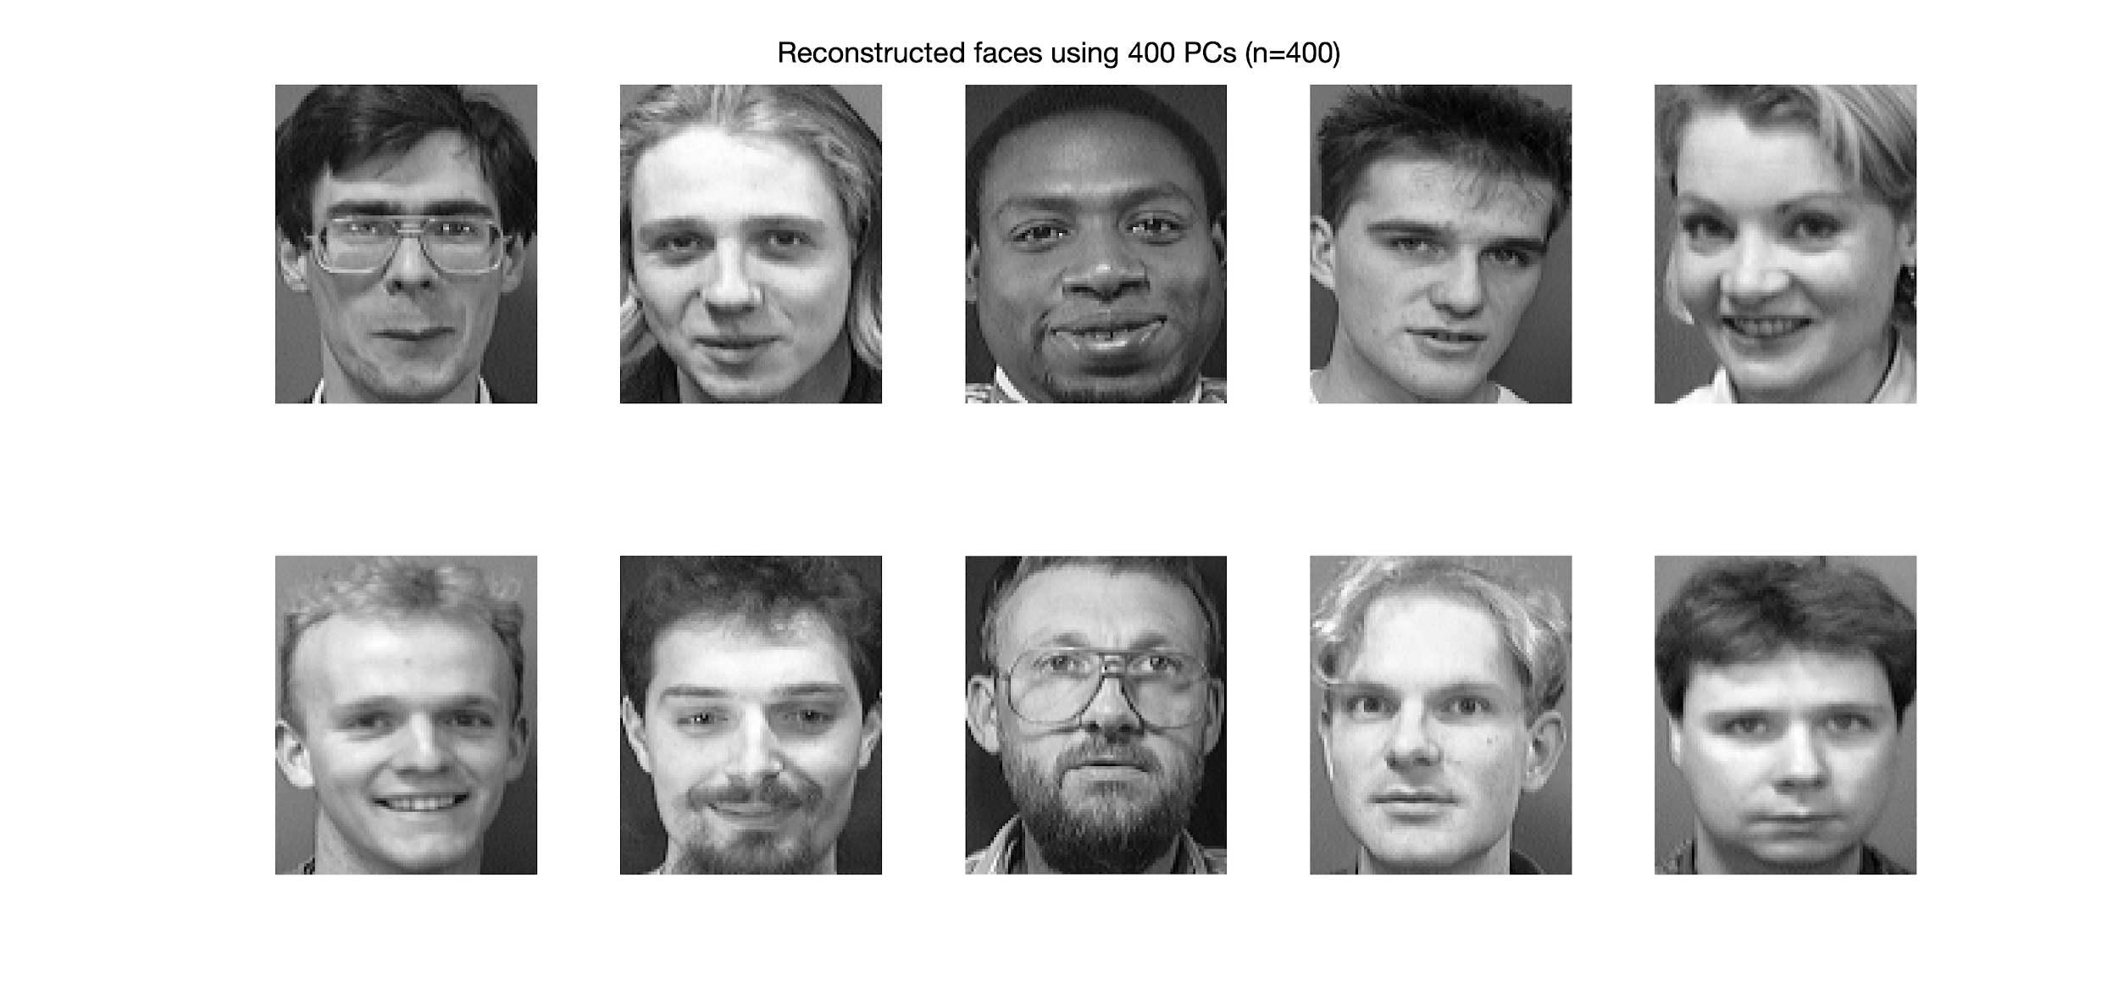
Differences between reconstructed and original images
Original Faces
Reconstructed Faces using 400 Eigenfaces

Slide 18
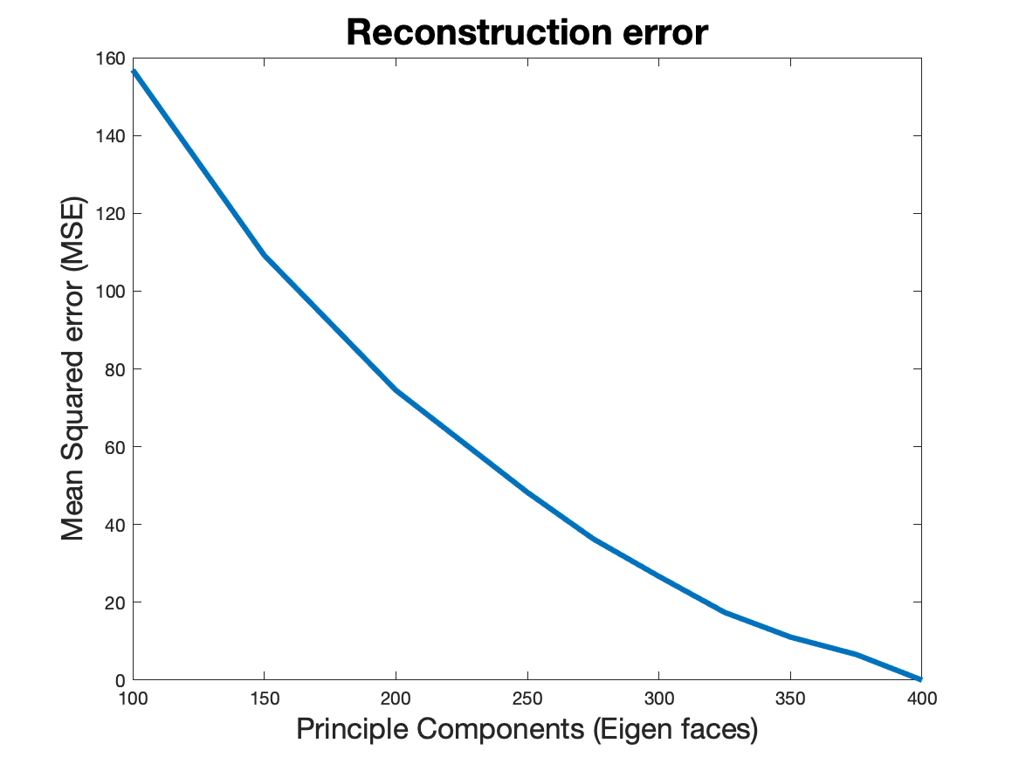
No. of eigenfaces required for reconstruction
Reasonable Error was defined by visual observation and Mean Squared Error (MSE):
350 Eigenfaces required
MSE of 11.073

Slide 19
Conclusion
Leading eigenfaces display fundamental facial features: chin, mouth, nose, ears, hair.
The first 50 eigenfaces represent around 81.6 % of total variance and the first 350 represent 99.42 %.
PCA able to reduce 10,304 dimensions to 350 dimensions with extremely low reconstruction error (MSE = 11.073). Also, for 400 dimensions (MSE ~ 0)

Slide 20
Questions?

